Slide 1
YouTube Data Extraction and Automation Workshop
The World Bank
Day 2 | Advanced Analytics Series

Slide 2
Agenda
Setup and obtaining the API key
Fetching top channels in Indonesia
Fetching video details using YouTube API v3
Fetching video URLs of a Channel using rendered webpage
Fetching Likes, Comments, Views and Description using rendered webpage
Estimation of Revenue

Slide 3


WARNING!
“YouTube’s terms prohibit commercial scraping, so this is purely for educational and capacity building purposes”

Slide 4
GitHub link
https://github.com/arindammisra/IndonesiaPoC

Slide 5
Tools and Environment
Python 3.x
Selenium + ChromeDriver
Requests + Regex
Pandas / NumPy
Webdriver-manager for auto driver setup
PowerShell / Terminal for execution:
Use of Selenium instead of requests to avoid blocking and capturing rendered content
pip install selenium pandas numpy requests webdriver-manager

Slide 6
Obtaining YouTube API key
Log in to the Google Cloud Console with your Google Account.
Create a New Project (recommended to avoid conflicts) by clicking the project dropdown at the top and selecting "New Project".
Enable the YouTube Data API v3 for your project:
  Navigate to the APIs & Services > Library from the navigation menu
  Search for "YouTube Data API v3" and select it from the results.
  Click the Enable button
Create Credentials to generate the key
  Go to APIs & Services > Credentials on the left menu
  Click + Create Credentials and select API key from the dropdown menu
Copy the Generated Key. An API key will appear in a pop-up window. Copy this key and store it securely as this will be used in the Python codes

Slide 7
What is the YouTube Data API?
Official API by Google for accessing public YouTube data.
Provides endpoints for channels, videos, playlists, search results, etc.
Uses REST over HTTPS and returns JSON data.
Capabilities:
  Fetch channel information and analytics.
  Retrieve video details, likes, comments, etc.
  Search for videos or channels.
  Analyze engagement trends.
Requires a Google Cloud project and API key
Each request includes the key via developerKey
Quota System - Each API request costs “quota units.”
Default daily limit: 10,000 units
  videos.list: 1 unit
  search.list: 100 units

Slide 8
Capabilities
Content Engagement: Track views, watch time, average view duration, likes/dislikes, comments, shares, and audience retention to assess how viewers interact with and respond to your videos.
Audience Insights: Analyze geographic data, age groups, and gender to understand who is watching and where, helping tailor content to target demographics and regions.
Subscriber Trends: Monitor subscribers gained and lost, and distinguish between new and returning viewers to evaluate channel growth and audience loyalty.
Traffic Sources: Identify how viewers discover your content (e.g., search, external sites, related videos, notifications) to optimize distribution and reach.
Playback & Technology: Review playback locations and device/operating system usage to inform content production and ensure accessibility across platforms.

Slide 9
First Step: Searching top Channels in Indonesia
Finds the top trending YouTube channels in Indonesia by:
  Fetching the most popular videos in Indonesia.
  Extracting their channel IDs and channel names
  Saving those to a local text file so they can be analyzed later
Key Concepts
  YouTube Data API v3
  API Key
  Endpoints - videos().list or channels().list
  JSON Responses

Slide 10
Fetching channels
Setup
  Imports Google’s client library
  Defines constants for API key, region, and output file
  REGION_CODE='ID' specifies Indonesia (using ISO country code)
Initialize API client
Load and Save Channels
  Keeps track of channels you’ve already saved (so no duplicates)
  Stores them in a text file
Fetch Trending Videos
  Uses the “videos.list” endpoint with the chart=mostPopular parameter to get the top trending videos in Indonesia
Iterates over all trending videos
Extracts the channelId and channelTitle
Adds any new channels to the file
Prints out how many were added

Slide 11
Fetching Video details
Load channels from the file.
Ask user:
  Fetch top N channels?
  Or just one specific channel ID?
For each channel:
  Print statistics.
  Ask how many recent videos to fetch.
  Print per-video stats.
Further analysis using prompts like:
  From the video description above augmented by an internet search analyze the following 1. The personal details of the Channel Owner 2. The other Social Media links of the Channel owner 3. Details of any promotion(s) found
  Read this description carefully and tell me : 1. Any promotions that you find in this and if yes, from whom. 2. Any other related social media links you find of the YouTuber 3. Any personal information that you find about the YouTuber

Slide 12
Fetching Video details
Sets up API access and prepares to load saved channel IDs
Load Channels and turns them into a list of [channel_id, channel_name]
Get Channel Statistics like:
  Title
  Description
  Published date
  Subscriber count
  Total views
  Total videos
Returns a list of videoIds — the building blocks for the next step
For each video, returns:
  Title
  Description – Can be analyzed using AI
  Views
  Likes
  Comments

Slide 13
Selenium based video URL fetching
Automatically scroll through a YouTube channel’s Videos page and capture the URLs of every video posted by that channel.
Goes to the channel’s video listing page
Installs and opens a Chrome browser using webdriver_manager
Scrolls to the bottom of the page repeatedly
YouTube loads more videos each time we scroll
Finds all <a> (anchor) elements that link to a YouTube video (each URL contains /watch?v=)
Outputs the file veritasium_video_urls.txt where each line is a direct YouTube video link for that channel

Slide 14
Extracting video details without API
Given a list of video URLs, the code extracts the metadata (views, likes, comments, etc.) and export to a CSV
Creates a CSV file and defines the columns for storing results
Creates a list of URLs - Hard-coded list (you could instead read these from the .txt file produced by the first script)
Same logic: launch Chrome, ready to visit YouTube videos
process_video() Function
  Opens the page
  Waits for elements to load (time.sleep + WebDriverWait)
  Extracts information

Slide 15
Data Extraction
Data | How It’s Extracted | Explanation
Title | re.search(r'<title>(.*?)</title>', html) | Finds <title> tag from HTML source.
Subscribers | Regex targeting id="owner-sub-count" | Extracts channel subscriber count.
Likes | Regex searching for numbers inside yt-spec-button-shape-next__button-text-content | Pulls like counts.
Views | driver.find_element(By.XPATH, '//*[@id="info"]/span[1]') | Locates the text showing total views.
Comments | Scrolls down, finds element at //*[@id='count']//span[1] | Loads comments section, extracts count.
Description | Finds element id="description-inline-expander" | Expands “Show more” if needed and reads full text.

Slide 16
Understanding CPM and Estimating YouTube Revenue
CPM stands for Cost Per Mille (Mille is Latin for thousand). It is the amount an advertiser pays for one thousand views or impressions of their advertisement on a YouTube video
CPM Variability: CPM is not a fixed number. It varies based on:
  Geographic location of the viewer (US views pay more than others).
  Time of year (higher during holiday seasons).
  Content Niche (finance videos pay more than kids' cartoons).
  Ad format (skippable vs. non-skippable ads).

Slide 17
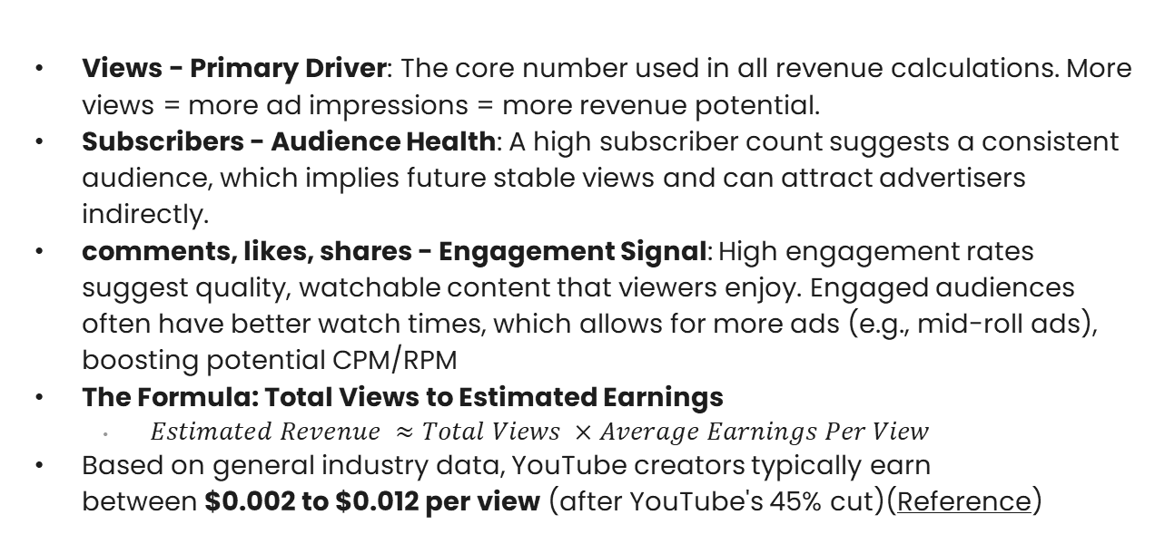
Understanding CPM and Estimating YouTube Revenue
Views - Primary Driver: The core number used in all revenue calculations. More views = more ad impressions = more revenue potential.
Subscribers - Audience Health: A high subscriber count suggests a consistent audience, which implies future stable views and can attract advertisers indirectly.
comments, likes, shares - Engagement Signal: High engagement rates suggest quality, watchable content that viewers enjoy. Engaged audiences often have better watch times, which allows for more ads (e.g., mid-roll ads), boosting potential CPM/RPM
The Formula: Total Views to Estimated Earnings
  $Estimated Revenue ≈Total Views ×Average Earnings Per View$
Based on general industry data, YouTube creators typically earn between $0.002 to $0.012 per view (after YouTube's 45% cut)(Reference)

Slide 18
Thank You

